Slide 1
Software Reliability

Slide 2
Software Reliability, Failures and Faults
The reliability of a software system is a measure of how well it provides the services expected by its users, expressed in terms of software failures.
A software failure is an execution event where the software behaves in an unexpected or undesirable way.
A software fault is an erroneous portion of a software system which may cause failures to occur if it is run in a particular state, or with particular inputs.

Slide 3
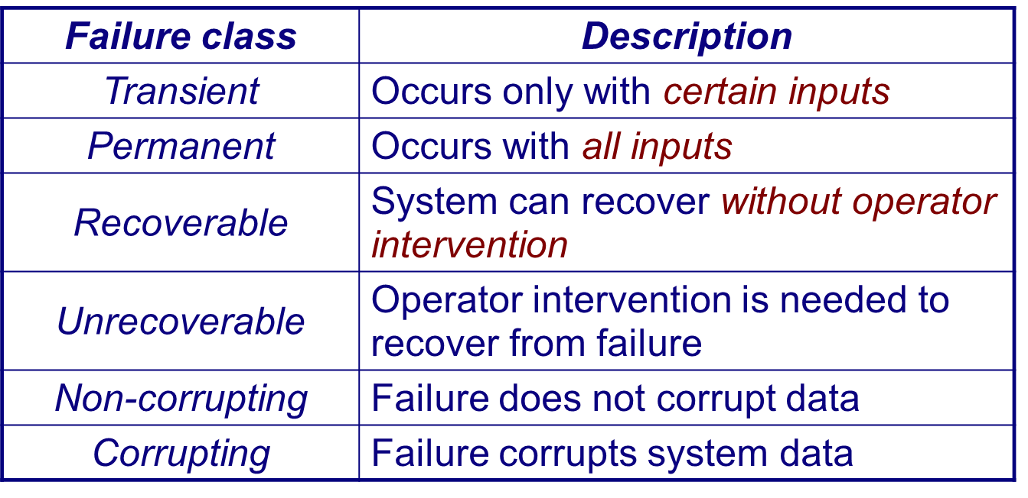
Kinds of failures

Slide 4
Programming for Reliability
Fault avoidance:
development techniques to reduce the number of faults in a system
Fault tolerance:
developing programs that will operate despite the presence of faults

Slide 5
Fault Avoidance
Fault avoidance depends on:
A precise system specification (preferably formal)
Software design based on information hiding and encapsulation
Extensive validation reviews during the development process
An organizational quality philosophy to drive the software process
Planned system testing to expose faults and assess reliability

Slide 6
Common Sources of Software Faults
Several features of programming languages and systems are common sources of faults in software systems:
Goto statements and other unstructured programming constructs make programs hard to understand, reason about and modify.
Use structured programming constructs
Floating point numbers are inherently imprecise and may lead to invalid comparisons.
Fixed point numbers are safer for exact comparisons
Pointers are dangerous because of aliasing, and the risk of corrupting memory
Pointer usage should be confined to abstract data type implementations

Slide 7
Common Sources of Software Faults….
Parallelism is dangerous because timing differences can affect overall program behavior in hard-to-predict ways.
Minimize inter-process dependencies
Recursion can lead to convoluted logic, and may exhaust (stack) memory.
Use recursion in a disciplined way, within a controlled scope
Interrupts force transfer of control independent of the current context, and may cause a critical operation to be terminated.
Minimize the use of interrupts; prefer disciplined exceptions

Slide 8
Fault Tolerance
A fault-tolerant system must carry out four activities:
Failure detection: detect that the system has reached a particular state or will result in a system failure
Damage assessment: detect which parts of the system state have been affected by the failure
Fault recovery: restore the state to a known, “safe” state (either by correcting the damaged state, or backing up to a previous, safe state)
Fault repair: modify the system so the fault does not recur (!)

Slide 9
Approaches to Fault Tolerance
N-version Programming:
Multiple versions of the software system are implemented independently by different teams.
The final system:
runs all the versions in parallel,
compares their results using a voting system, and
rejects inconsistent outputs. (At least three versions should be available!)

Slide 10
Approaches to Fault Tolerance ...
Recovery Blocks:
A finer-grained approach in which a program unit contains a test to check for failure, and alternative code to back up and try in case of failure.
alternatives are executed in sequence, not in parallel
the failure test is independent (not by voting)

Slide 11
Defensive Programming
Failure detection:
Use the type system to ensure that variables do not get assigned invalid values.
Use assertions to detect failures and raise exceptions. Explicitly state and check all invariants for abstract data types, and pre- and post-conditions of procedures as assertions. Use exception handlers to recover from failures.
Use damage assessment procedures, where appropriate, to assess what parts of the state have been affected, before attempting to fix the damage.
Fault recovery:
Backward recovery: backup to a previous, consistent state
Forward recovery: make use of redundant information to reconstruct a consistent state from corrupted data

Slide 12
Software Reliability Models

Slide 13
What is Reliability?
Reliability is applied whenever we expect something to behave in a certain way.
Reliability is one of the metrics that are used to measure quality.
It is a user-oriented quality factor relating to system operation.
Intuitively, if the users of a system rarely experience failure, the system is considered to be more reliable than one that fails more often.
A system without faults is considered to be highly reliable.
Constructing a correct system is a difficult task.
Even an incorrect system may be considered to be reliable if the frequency of failure is “acceptable.”
Key concepts in discussing reliability:
Fault, Failure, Time
Three kinds of time intervals: MTTR (Mean Time to Recover), MTTF (Mean Time to Failure), MTBF (Mean Time Between Failure)

Slide 14
What is Reliability?
Failure
A failure is said to occur if the observable outcome of a program execution is different from the expected outcome.
Fault
The adjudged cause of failure is called a fault.
Example: A failure may be caused by a defective block of code.
Time
Time is a key concept in the formulation of reliability. If the time gap between two successive failures is short, we say that the system is less reliable.
Two forms of time are considered.
Execution time (τ)
Calendar time (t)

Slide 15
What is Reliability?
Two ways to measure reliability
Counting failures in periodic intervals
Observe the trend of cumulative failure count - µ(τ).
Failure intensity
Observe the trend of number of failures per unit time – λ(τ).
µ(τ)
This denotes the total number of failures observed until execution time τ from the beginning of system execution.
λ(τ)
This denotes the number of failures observed per unit time after τ time units of executing the system from the beginning. This is also called the failure intensity at time τ.
Relationship between λ(τ) and µ(τ) λ(τ) = dµ(τ)/dτ

Slide 16
Definitions of Software Reliability
First definition
Software reliability is defined as the probability of failure-free operation of a software system for a specified time in a specified environment.
Key elements of the above definition
Probability of failure-free operation
Length of time of failure-free operation
A given execution environment
Example
The probability that a PC in a store is up and running for eight hours without crash is 0.99.
Second definition
Failure intensity is a measure of the reliability of a software system operating in a given environment.
Example: An air traffic control system fails once in two years.
Comparing the two
The first puts emphasis on MTTF, whereas the second on count.

Slide 17
Factors Influencing Software Reliability
A user’s perception of the reliability of a software depends upon two categories of information.
The number of faults present in the software.
The ways users operate the system.
This is known as the operational profile.
The fault count in a system is influenced by the following.
Size and complexity of code
Characteristics of the development process used
Education, experience, and training of development personnel
Operational environment

Slide 18
Applications of Software Reliability
Comparison of software engineering technologies
What is the cost of adopting a technology?
What is the return from the technology -- in terms of cost and quality?
Measuring the progress of system testing
Key question: How testing has been done?
The failure intensity measure tells us about the present quality of the system: high intensity means more tests are to be performed.
Controlling the system in operation
The amount of change to a software for maintenance affects its reliability. Thus the amount of change to be effected in one go is determined by how much reliability we are ready to potentially lose.
Better insight into software development processes
Quantification of quality gives us a better insight into the development processes.

Slide 19
Reliability Models
Main idea
We develop mathematical models for λ(τ) and µ(τ).
Basic assumptions in developing a reliability model
Faults in the program are independent.
Execution time between failures is large w.r.t. instruction execution time.
Potential test space covers its use space.
The set of inputs per test run is randomly chosen.
The fault causing a failure is immediately fixed or else its re-occurrence is not counted again.

Slide 20
Reliability Models
Intuitive idea
As we observe another system failure and the corresponding fault is fixed, there will be fewer number of faults remaining in the system and the failure intensity will be smaller with each fault fixed.
In other words, as the cumulative failure count increases, the failure intensity decreases.
Two decrement processes
Decrement process 1
The decrease in failure intensity after observing a failure and fixing the corresponding fault is constant.
This gives us the Basic model.
Decrement process 2
The decrease in failure intensity after observing a failure and fixing the corresponding fault is smaller than the previous decrease.
This gives us the Logarithmic model.

Slide 21
Reliability Models
Fig: Failure intensity λ as a function of cumulative failures µ.
Parameters of the models
λ₀: The initial failure intensity observed at the beginning of system testing.
v₀: The total number of system failures that we expect to observe over infinite time starting from the beginning of system testing.
θ: A parameter representing non-linear drop in failure intensity in the Logarithmic model.

Slide 22
Reliability Models
Fig: Failure intensity λ as a function of execution time τ (λ₀ = 9 failures/unit time, v₀ = 500 failures, θ = 0.0075).
Basic model
Assumption:
λ(µ) = λ₀ (1 - µ/v₀)
dµ(τ)/dτ = λ₀ (1 - µ(τ)/v₀)
µ(τ) = λ₀ (1 - µ/v₀)
λ(τ) = λ₀.e ^{-λ0 τ/v0}
Logarithmic model
Assumption:
λ(µ) = λ₀e^{-θµ}
dµ(τ)/dτ = λ₀e^{-θµ(τ)}
µ(τ) = ln(λ₀θτ + 1)/θ
λ(τ) = λ₀/(λ₀θτ + 1)

Slide 23
Fig: Cumulative failure µ as a function of execution time τ (λ₀ = 9 failures/unit time, v₀ = 500 failures, θ = 0.0075).

Slide 24
Reliability Models
Example
Assume that a software system is undergoing system level testing. The initial failure intensity (^{λ0}) of the system was 25 failures/CPU hours, and the current failure intensity is 5 failures/CPU hour. It has been decided by the project manager that the system will be released only after the system reaches a reliability level of at most 0.001 failures/CPU hour. From their experience the management team estimates that the system will experience a total of 1200 failures over infinite time. Calculate the additional length of system testing required before the system can be released.
The system will experience a total of 1200 failures over infinite time (v₀). Thus, we use the Basic model.
λ_{c} and λ_{r} are the current failure intensity and the failure intensity at the time of release.
Assume that current failure intensity has been achieved after executing the system for τ_{c} hours.
Let λ_{r} be achieved after testing the system for a total of τ_{r} hours.

Slide 25
(Example continued)
(τ_{r} - τ_{c}) denotes the additional execution time required to achieve λ_{r}.
We can write λ_{c} and λ_{r} as follows.
λ_{c} = λ₀.e ^{-λ0 τc/v0}
λ_{r} = λ₀.e ^{-λ0 τr/v0}
λ_{c} / λ_{r} = (λ₀.e ^{-λ0 τc/v0})/(λ₀.e ^{-λ0 τr/v0})
= e ^{(τr - τc) λ0/v0}
ln(λ_{c} / λ_{r}) = (τ_{r} - τ_{c}) λ₀/v₀
(τ_{r} - τ_{c}) = (v₀/ λ₀)ln(λ_{c} / λ_{r})
= (1200/25)ln(5/0.001)
= 408.825 hours
It is required to test the system for more time so that the CPU runs for another 408.825 hours to achieve the reliability level of 0.001 failures/hour.

Slide 26
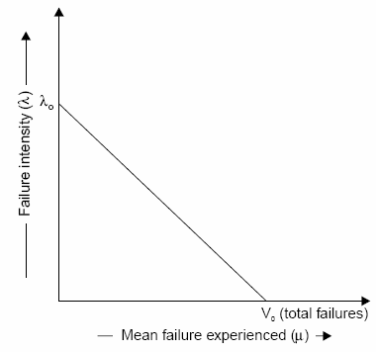
Software Reliability Models
Basic Execution Time Model
⎛ μ ⎞
⎜
⎟
λ(μ) = λ 1−
(1)
0
⎜
V
⎟
⎝
0 ⎠
Fig: Failure intensity λ as a function of µ for basic model

Slide 27
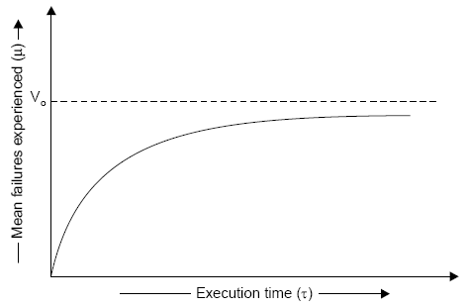
Software Reliability
dλ ₌ − λ₀
dμ V₀
(2)
Fig.7.14: Relationship between τ & µ for basic model

Slide 28
Software Reliability
For a derivation of this relationship, equation 1 can be written as:
dμ(τ )
⎛
μ(τ ) ⎞
= λ_{0 ⎜}⎜1−
⎟⎟
dτ
V₀
⎝ ⎠
The above equation can be solved for μ(τ ) and result in :
⎛
⎛ − λ τ ⎞⎞
⎜ −
⎜ 0 ⎟⎟
μ(τ ) = V 1 exp⎜
0
⎜
V
⎟⎟
⎝
⎝
⎠⎠
(3)
0

Slide 29
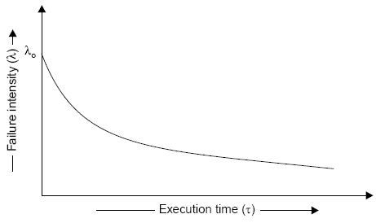
Software Reliability
The failure intensity as a function of execution time is shown in figure given below
⎛ − λ τ ⎞
λ(τ ) = λ exp
⎜ ⎟
⎜
0
V₀
⎟
0
⎝
⎠
Fig.7.15: Failure intensity versus execution time for basic model

Slide 30
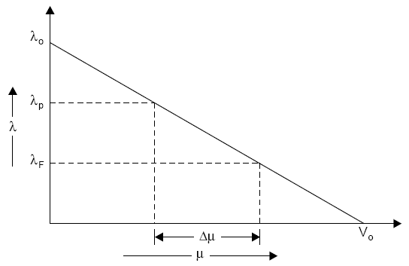
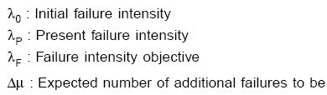
Software Reliability
Derived quantities
Fig.7.16: Additional failures required to be experienced to reach the objective
51

Slide 31
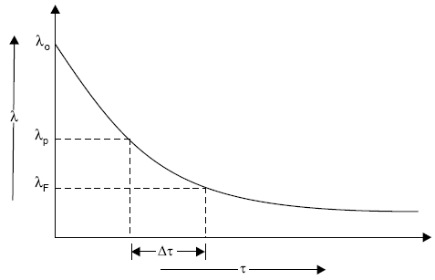
Software Reliability
Fig.7.17: Additional time required to reach the objective
This can be derived in mathematical form as:
V
⎛ λ ⎞
Δτ = ⁰ Ln⎜⎜ ^{P} ⎟⎟
λ₀
⎝ ^{λ}F ⎠

Slide 32
Example- 7.1
Assume that a program will experience 200 failures in infinite time. It has now experienced 100. The initial failure intensity was 20 failures/CPU hr.
Determine the current failure intensity.
Find the decrement of failure intensity per failure.
Calculate the failures experienced and failure intensity after 20 and 100 CPU hrs. of execution.
Compute additional failures and additional execution time required to reach the failure intensity objective of 5 failures/CPU hr.
Use the basic execution time model for the above mentioned calculations.

Slide 33
Solution
Here
Total failures experienced (V_{o}) = 200 failures
Mean failures experienced (μ) = 100 failures
Initial failure intensity (λ₀) = 20 failures/CPU hr.
(i) Current failure intensity:
⎛ μ ⎞
⎜
⎟
λ(μ) = λ 1−
0
⎜
V
⎟
⎝ 0 ⎠
⎛ ⎞
= 20⎜1− ¹⁰⁰ ⎟ = 20(1− 0.5) = 10 failures/CPU hr
⎝
200 ⎠

Slide 34
(ii) Decrement of failure intensity per failure can be calculated as:
dλ ₌ − λ₀
= − ²⁰ = −0.1/ CPU hr.
200
dμ V₀
(iii) (a) Failures experienced & failure intensity after 20 CPU hr:
⎛
⎛ − λ τ ⎞⎞
⎜ −
⎜ 0 ⎟⎟
μ(τ ) = V 1 exp⎜
⎟⎟
0
⎜
V
⎝
⎝ 0 ⎠⎠
⎛
⎛ − × ⎞⎞
= 200⎜1− exp⎜ ²⁰ ²⁰ ⎟⎟ = 200(1− exp(1− 2))
⎝
⎝
200
⎠⎠
= 200(1− 0.1353) ≈ 173failures

Slide 35
⎛ − λ τ ⎞
λ(τ ) = λ exp
⎜ ⎟
⎜
0
V₀
⎟
0
⎝ ⎠
⎛ − ×
⎞
= 20 exp⎜ ²⁰ ²⁰ ⎟ = 20 exp(−2) = 2.71 failures / CPU hr
200
⎝ ⎠
(b) Failures experienced & failure intensity after 100 CPU hr:
⎛
⎛ − λ τ ⎞⎞
⎜ −
⎜ 0 ⎟⎟
μ(τ ) = V 1 exp⎜
⎟⎟
0
⎜
V
⎝
⎝ 0 ⎠⎠
⎛ ⎛ − ×
⎞⎞
= 200⎜1− exp⎜ ²⁰ ¹⁰⁰ ⎟⎟ = 200 failures (almost)
⎝
⎝
200
⎠⎠
⎛ − λ τ ⎞
λ(τ ) = λ exp
⎜ ⎟
⎜
0
V₀
⎟
0
⎝
⎠
⎛ − ×
⎞
= 20 exp⎜ ²⁰ ¹⁰⁰ ⎟ = 0.000908 failures / CPU hr
200
⎝ ⎠

Slide 36
(iv) Additional failures (Δμ ) required to reach the failure intensity objective of 5 failures/CPU hr.
⎛ V ⎞
⎛ ⎞
Δμ = ⎜⎜ ⁰ ⎟⎟(λ
− λ ) = ⎜ ²⁰⁰ ⎟(10 − 5) = 50 failures
λ₀
P
F
⎝
20 ⎠
⎝ ⎠

Slide 37
Additional execution time required to reach failure intensity objective of 5 failures/CPU hr.
⎛ V ⎞ ⎛ λ ⎞
Δτ = ⎜⎜ ⁰ ⎟⎟Ln⎜⎜ ^{P} ⎟⎟
⎝ ^{λ}0 ⎠ ⎝ ^{λ}F ⎠
⎛ ⎞
= ²⁰⁰ Ln⎜ ¹⁰ ⎟ = 6.93 CPU hr.
20
⎝ 5 ⎠

Slide 38
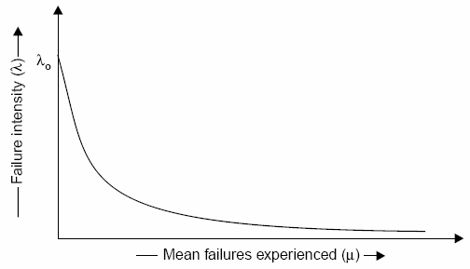
Logarithmic Poisson Execution Time Model Failure Intensity
λ(μ) = λ₀ exp(−θμ)
Fig.7.18: Relationship between

Slide 39
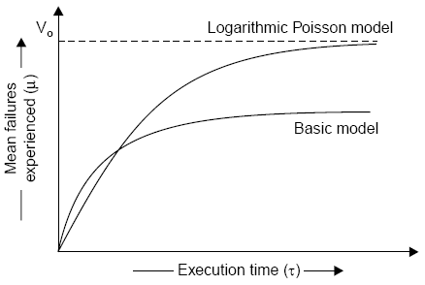
dλ
dλ
= −λ₀θ exp(−μθ )
dμ
= −θλ
dμ
Fig.7.19: Relationship

Slide 40
μ(τ ) = ¹ Ln(λ θτ +1)
θ
0
λ(τ ) = λ₀ /(λ₀θτ +1)
1
⎛ λ ⎞
λ = Present failure intensity
P
Δμ =
_{Ln⎜⎜} P ⎟⎟
λ = Failure intensity objective
θ
⎝ ^{λ}F ⎠
F
1 ⎡ 1
1 ⎤
(4)
Δτ =
⎢
−
⎥
θ ⎣ λ_{F}
^{λ}P ⎦

Slide 41
Example- 7.2
Assume that the initial failure intensity is 20 failures/CPU hr. The failure intensity decay parameter is 0.02/failures. We have experienced 100 failures up to this time.
Determine the current failure intensity.
Calculate the decrement of failure intensity per failure.
Find the failures experienced and failure intensity after 20 and 100 CPU hrs. of execution.
Compute the additional failures and additional execution time required to reach the failure intensity objective of 2 failures/CPU hr.
Use Logarithmic Poisson execution time model for the above mentioned calculations.

Slide 42
Solution
λ₀ = 20 failures/CPU hr.
μ = 100 failures
θ = 0.02 / failures
(i) Current failure intensity:
λ(μ) = λ₀ exp(−θμ)
= 20 exp (-0.02 x 100)
= 2.7 failures/CPU hr.

Slide 43
Decrement of failure intensity per failure can be calculated as:
^{dλ} = −θλ
dμ
= -0.02 x 2.7 = -0.054/CPU hr.
(a) Failures experienced & failure intensity after 20 CPU hr:
μ(τ ) = ¹ Ln(λ θτ +1)
θ
0
= ¹ Ln(20 × 0.02 × 20 +1) = 109 failures
0.02

Slide 44
λ(τ ) = λ₀ /(λ₀θτ +1)
= (20) /(20 ×.02 × 20 +1) = 2.22 failures / CPU hr.
(b) Failures experienced & failure intensity after 100 CPU hr:
μ(τ ) = ¹ Ln(λ θτ +1)
θ
0
= ¹ Ln(20 × 0.02 ×100 +1) = 186 failures
0.02
λ(τ ) = λ₀ /(λ₀θτ +1)
= (20) /(20 ×.02 ×100 +1) = 0.4878 failures / CPU hr.

Slide 45
(iv) Additional failures (Δμ ) required to reach the failure intensity objective of 2 failures/CPU hr.
1 λ_{P} 1
θ λ_{F} 0.02
⎛
2.7
⎞
Δμ =
Ln =
Ln⎜
⎟ = 15 failures
⎝ 2 ⎠
⎡
⎤
⎡
⎤
Δτ = ¹ ⎢ ¹ − ¹ ⎥ = ¹ ⎢ ¹ − ¹ ⎥ = 6.5 CPU hr.
θ ⎣ λ_{F}
^{λ}P ⎦
0.02 ⎣ 2
2.7 ⎦

Slide 46
Example- 7.3
The following parameters for Basic and Logarithmic Poisson models are given:
Determine the addition failures and additional execution time required to reach the failure intensity objective of 5 failures/CPU hr. for both models.
Repeat this for an objective function of 0.5 failure/CPU hr. Assume that we start with the initial failure intensity only.
Basic execution time model | Logarithmic Poisson execution time model
λ = 10 failures/CPU hr o | λ = 30 failures/CPU hr o
V = 100 failures o | θ = 0.25 / failure

Slide 47
Solution
(a) (i) Basic execution time model
Δμ = ^{V0} (λ − λ )
λ₀
P
F
= ¹⁰⁰ (10 − 5) = 50 failures
10
λ_{P} (Present failure intensity) in this case is same as λ₀ (initial failure intensity).
Now,
V
⎛ λ ⎞
⎛ ⎞
Δτ = ⁰ Ln⎜⎜ ^{P} ⎟⎟
= ¹⁰⁰ Ln⎜ ¹⁰ ⎟ = 6.93 CPU hr.
λ₀
⎝ ^{λ}F ⎠
10
⎝
5 ⎠

Slide 48
(ii) Logarithmic execution time model
1
θ
⎛ λ ⎞
Δμ =
_{Ln⎜⎜} P ⎟⎟
⎝ ^{λ}F ⎠
⎛ ⎞
= ¹ Ln⎜ ³⁰ ⎟ = 71.67 Failures
0.025
⎝ 5 ⎠
1 ⎛ 1
1 ⎞
Δτ =
⎜⎜
−
⎟⎟
θ ⎝ λ_{F}
^{λ} P ⎠
⎛ ⎞
= ¹ Ln⎜ ¹ − ¹ ⎟ = 6.66 CPU hr.
0.025
⎝ 5 30 ⎠
Logarithmic model has calculated more failures in almost some duration of execution time initially.

Slide 49
(b) Failure intensity objective (λ_{F} ) = 0.5 failures/CPU hr.
(i) Basic execution time model
V₀ ⎛ λ_{P} ⎞
(λ_{P} − λ_{F} )
V₀
Δμ =
Δτ =
Ln⎜⎜
⎟⎟
λ₀
λ₀
⎝ ^{λ}F ⎠
⎛ ⎞
= ¹⁰⁰ (10 − 0.5) = 95 failures
10
= ¹⁰⁰ Ln⎜ ¹⁰ ⎟ = 30 CPU /hr
10 ⎝ 0.05 ⎠

Slide 50
(ii) Logarithmic execution time model
1
θ
⎛ λ ⎞
Δμ =
_{Ln⎜⎜} P ⎟⎟
⎝ ^{λ}F ⎠
⎛ ⎞
= ¹ Ln⎜ ³⁰ ⎟ = 164 failures
0.025
⎝
0.5 ⎠
1 ⎛ 1
1 ⎞
Δτ =
⎜⎜
−
⎟⎟
θ ⎝ λ_{F}
^{λ}P ⎠
⎛ ⎞
= ¹ ⎜ ¹ − ¹ ⎟ = 78.66 CPU /hr
0.025 0.5 30 ⎠
⎝

Slide 51
Calendar Time Component
The calendar time component is based on a debugging process model. This model takes into account:
resources used in operating the program for a given execution time and processing an associated quantity of failure.
resources quantities available, and
the degree to which a resource can be utilized (due to bottlenecks) during the period in which it is limiting.
Table 7.7 will help in visualizing these different aspects of the resources, and the parameters that result.

Slide 52
Resource usage
 | Usage parameters requirements per |  | Planned parameters
Resource | CPU hr | Failure | Quantities available | Utilisation
Failure identification personnel | θ_{I} | µ_{I} | P_{I} | 1
Failure correction personnel | 0 | µ_{f} | P_{f} | P_{f}
Computer time | θc | µ_{c} | P_{c} | P_{c}
Fig. : Calendar time component resources and parameters

Slide 53
Hence, to be more precise, we have
X_{C} = μ_{c} Δμ + θ_{c} Δτ
(for computer time)
X _{f} = μ _{f} Δμ
(for failure correction)
X _{I} = μ_{I} Δμ + θ_{I} Δτ
(for failure identification)
dx_{T} / dτ = θ_{r} + μ_{r} λ

Slide 54
Calendar time to execution time relationship
dt / dτ = (1/ P_{r} p_{r} )dx_{T} / dτ
dt / dτ = (θ_{r} + μ_{r} λ) / P_{r} p_{r}

Slide 55
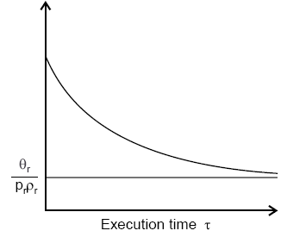
Fig.7.20: Instantaneous calendar time to execution time ratio

Slide 56
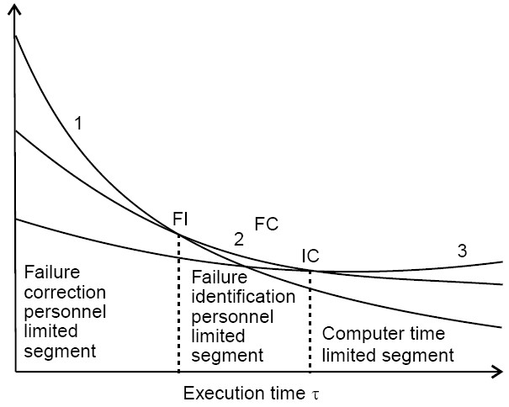
Fig.7.21: Calendar time to execution time ratio for different limiting resources

Slide 57
Example- 7.4
A team run test cases for 10 CPU hrs and identifies 25 failures. The effort required per hour of execution time is 5 person hr. Each failure requires 2 hr. on an average to verify and determine its nature. Calculate the failure identification effort required.

Slide 58
Solution
As we know, resource usage is:
X_{r} = θ_{r}τ + μ_{r} μ
θ_{r} = 15 person hr.
τ = 10 CPU hrs.
Here
μ = 25 failures
μ_{r} = 2 hrs./failure
Hence,
X_{r} = 5 (10) + 2 (25)
= 50 + 50 = 100 person hr.

Slide 59
Example- 7.5
Initial failure intensity (λ₀ ) for a given software is 20 failures/CPU hr. The failure intensity objective (λ_{F} ) of 1 failure/CPU hr. is to be achieved. Assume the following resource usage parameters.
Resource Usage | Per hour | Per failure
Failure identification effort | 2 Person hr. | 1 Person hr.
Failure Correction effort | 0 | 5 Person hr.
Computer time | 1.5 CPU hr. | 1 CPU hr.
What resources must be expended to achieve the reliability improvement? Use the logarithmic Poisson execution time model with a failure intensity decay parameter of 0.025/failure.
If failure intensity objective is cut to half, what is the effect on requirement of resources?

Slide 60
Solution
(a)
1
⎛ λ_{P} ⎞
Δμ = Ln⎜⎜
θ λ
⎟⎟
⎝ F ⎠
⎛ ⎞
= ¹ Ln⎜ ²⁰ ⎟ = 119 failures
0.025
⎝ 1 ⎠
1 ⎛ 1
1 ⎞
Δτ =
⎜⎜
−
⎟⎟
θ ⎝ λ_{F}
^{λ}P ⎠
⎛
⎞
= ¹ ⎜ ¹ − ¹ ⎟ = ¹ (1− 0.05) = 38 CPU hrs.
0.025 1 20 ⎠
0.025
⎝

Slide 61
X_{F} = μ_{F} Δμ
= 5 (119) = 595 Person hrs.
X_{C} = μ_{c}Δμ +θ_{c}Δτ
= 1 (119) + (1.5) (38) = 176 CPU hr.
Hence
X₁ = μ₁Δμ + θ₁Δτ
= 1 (119) + 2 (38) = 195 Person hrs.

Slide 62
(b)
λ_{F} = 0.5 failures/CPU hr.
⎛ ⎞
Δμ = ¹ Ln⎜ ²⁰ ⎟ = 148 failures
0.025
⎝ 0.5 ⎠
_{Δτ =} 1 ⎛ 1 1 ⎞
⎜ − ⎟ = 78 CPU hr.
0.025 ⎝ 0.5 20 ⎠
So,
X_{I} = 1 (148) + 2 (78) = 304 Person hrs.
X_{F} = 5 (148) = 740 Person hrs.
X_{C} = 1 (148) + (1.5)(78) = 265 CPU hrs.

Slide 63
Hence, if we cut failure intensity objective to half, resources requirements are not doubled but they are some what less. Note that Δτ is approximately doubled but increases logarithmically. Thus, the resources increase will be between a logarithmic increase and a linear increase for changes in failure intensity objective.

Slide 64
Example- 7.6
A program is expected to have 500 faults. It is also assumed that one fault may lead to one failure only. The initial failure intensity was 2 failures/CPU hr. The program was to be released with a failure intensity objective of 5 failures/100 CPU hr. Calculated the number of failure experienced before release.

Slide 65
Solution
The number of failure experienced during testing can be calculated using the equation mentioned below:
V₀
(λ_{P} − λ_{F} )
Δμ =
λ₀
Here
V₀ = 500 because one fault leads to one failure
λ₀ = 2 failures/CPU hr.
λ_{F} = 5 failures/100 CPU hr.
= 0.05 failures/CPU hr.

Slide 66
Δμ = ⁵⁰⁰ (2 − 0.05)
2
= 487 failures
So
Hence 13 faults are expected to remain at the release instant of the software.

Slide 67
▪ ISO 9000
The SEI capability maturity model initiative is an attempt to improve software quality by improving the process by which software is developed.
ISO-9000 series of standards is a set of document dealing with quality systems that can be used for quality assurance purposes. ISO-9000 series is not just software standard. It is a series of five related standards that are applicable to a wide variety of industrial activities, including design/ development, production, installation, and servicing. Within the ISO 9000 Series, standard ISO 9001 for quality system is the standard that is most applicable to software development.

Slide 68
Mapping ISO 9001 to the CMM
Management responsibility
Quality system
Contract review
Design control
Document control
Purchasing
Purchaser-supplied product
Process control
Inspection and testing
Inspection, measuring and test equipment
Inspection and test status
Control of nonconforming product
Corrective action
Product identification and traceability
Quality records

Slide 69
Handling, storage, packaging and delivery
Internal quality audits
Training
Servicing
Statistical techniques

Slide 70
Contrasting ISO 9001 and the CMM
There is a strong correlation between ISO 9001 and the CMM, although some issues in ISO 9001 are not covered in the CMM, and some issues in the CMM are not addressed in ISO 9001.
The biggest difference, however, between these two documents is the emphasis of the CMM on continuous process improvement.
The biggest similarity is that for both the CMM and ISO 9001, the bottom line is “Say what you do; do what you say”.

